Slide 1
EE PERK
Registration and order process for customers using the perk discount

Slide 2

STEP 1– GO TO EE.CO.UK/PERK
An employee can use up to 5 discount codes.
To access the discount codes, the employee first needs to register on our Perk website.
This can be done by going to the Perk page at ee.co.uk/perk and clicking on the ‘Perk Portal’ link. This will take them to the registration page.

Slide 3
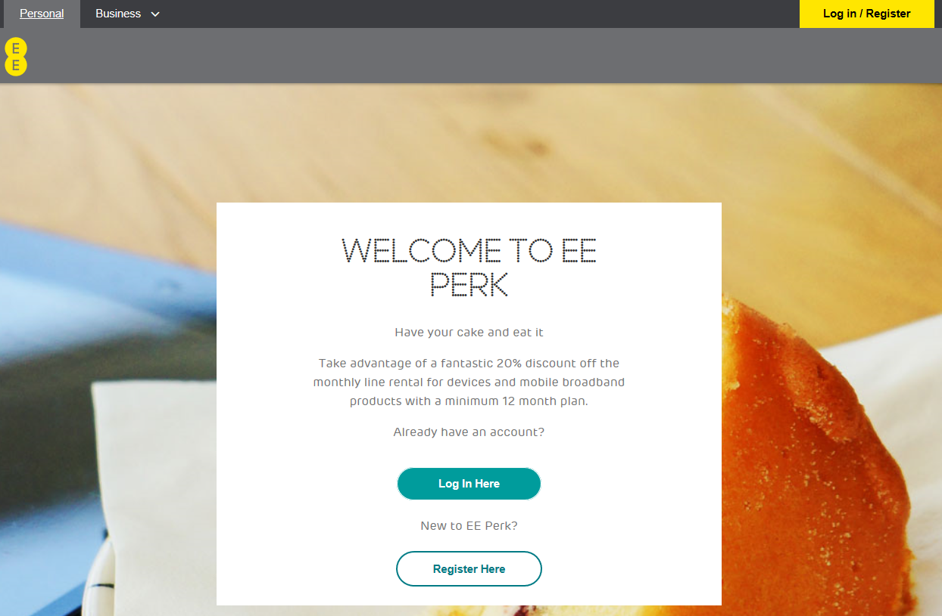
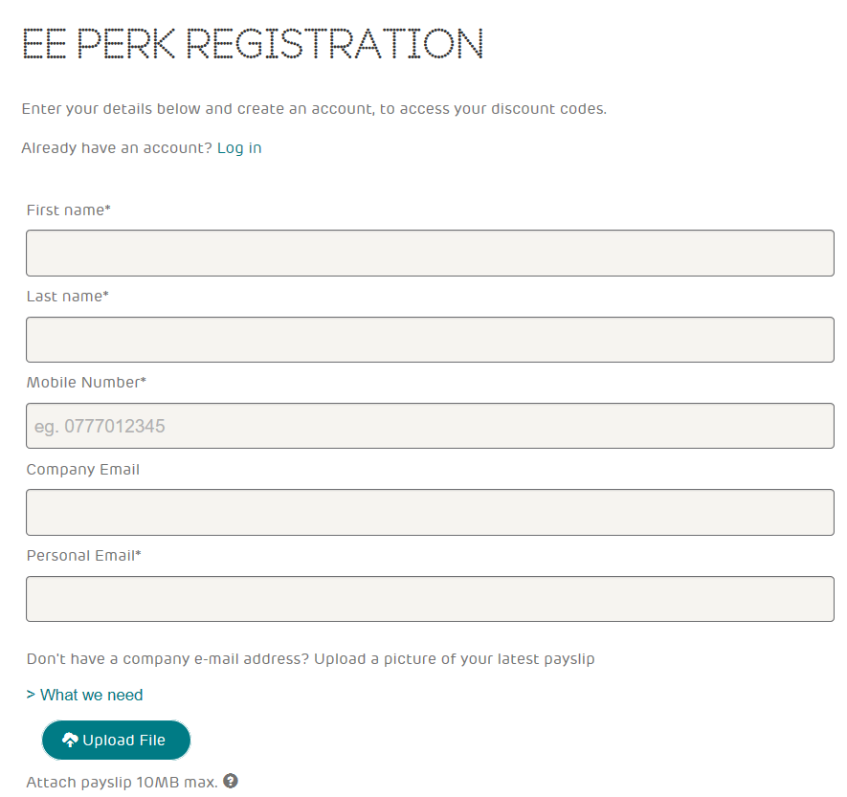
STEP 2a–REGISTER WITH COMPANY EMAIL
The employee will need their work email address. If the employee does not have an employee registered email address they can register with a personal email and employee identification card.

Slide 4
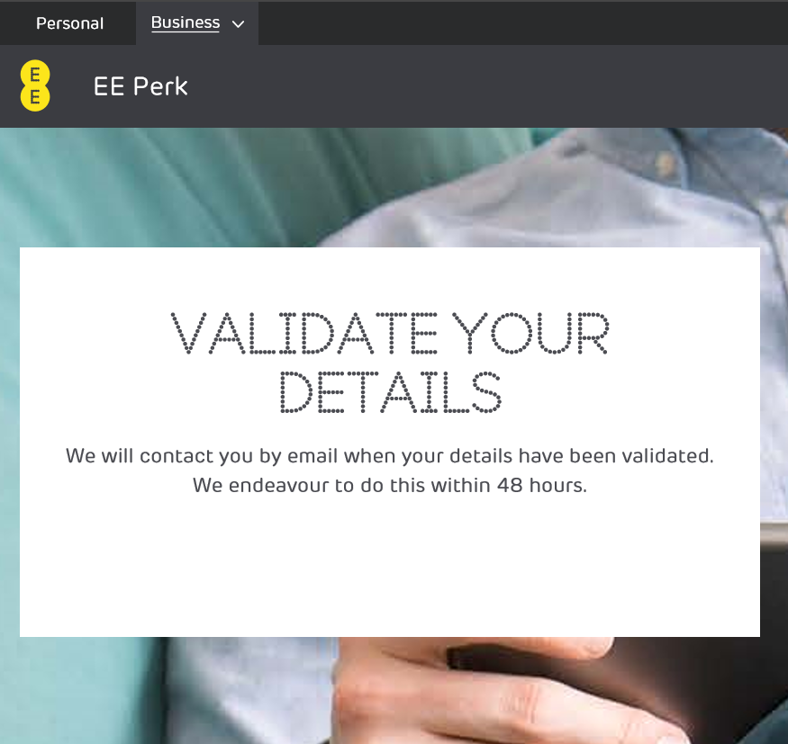
STEP 2b - REGISTER WITH PHOTO ID CARD
If an employee has uploaded a photo of their identity card as verification they will see this screen when the upload is complete.
They must remember to also include their personal email address.
An email will be sent to this address once validation is complete.

Slide 5
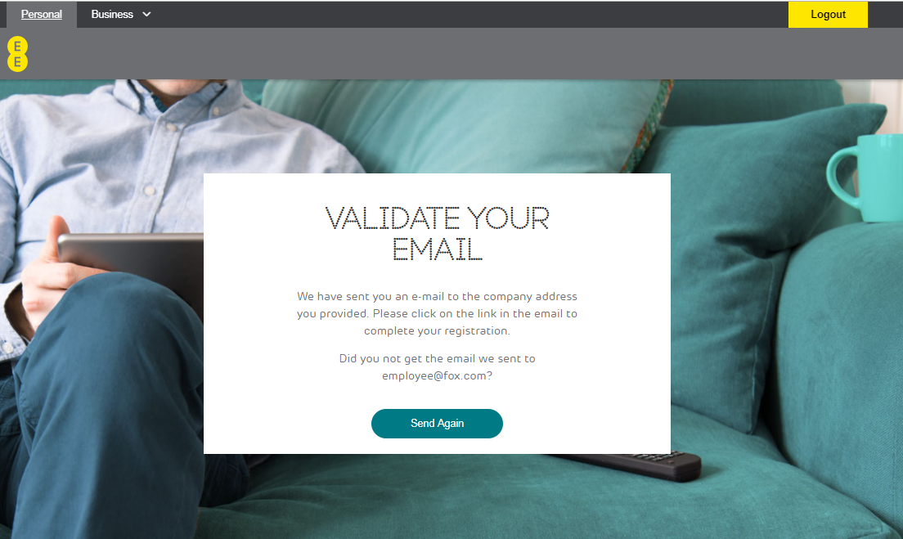
STEP 3– VERIFICATION
Once registration is complete, the employee (whether with a company email address or ID card) will receive a verification email immediately.
When the email is received, they must click on the link to verify, which will then take them straight to the Perk portal login screen.
Failure to verify will result in deactivated accounts
Please note: Failure to verify the email within 30 days of registration will result in deactivation and a failed registration.
If this occurs, please email perks.ee.co.uk
for an account reset

Slide 6
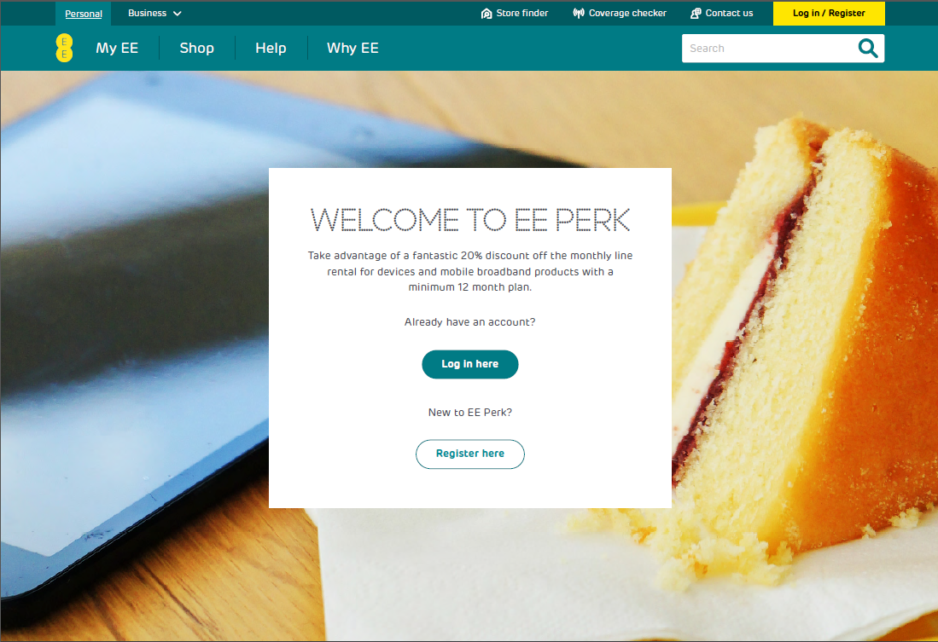
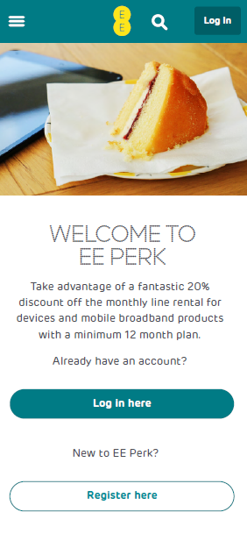
STEP 4 – HOME PAGE
Employee clicks on ‘log in here’
WEB VERSION
MOBILE VERSION

Slide 7
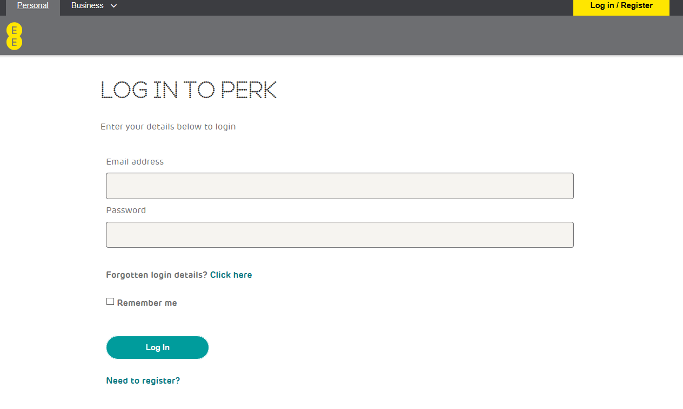
STEP 5 – LOGIN PAGE
Customer enters details to login and retrieve discount codes

Slide 8
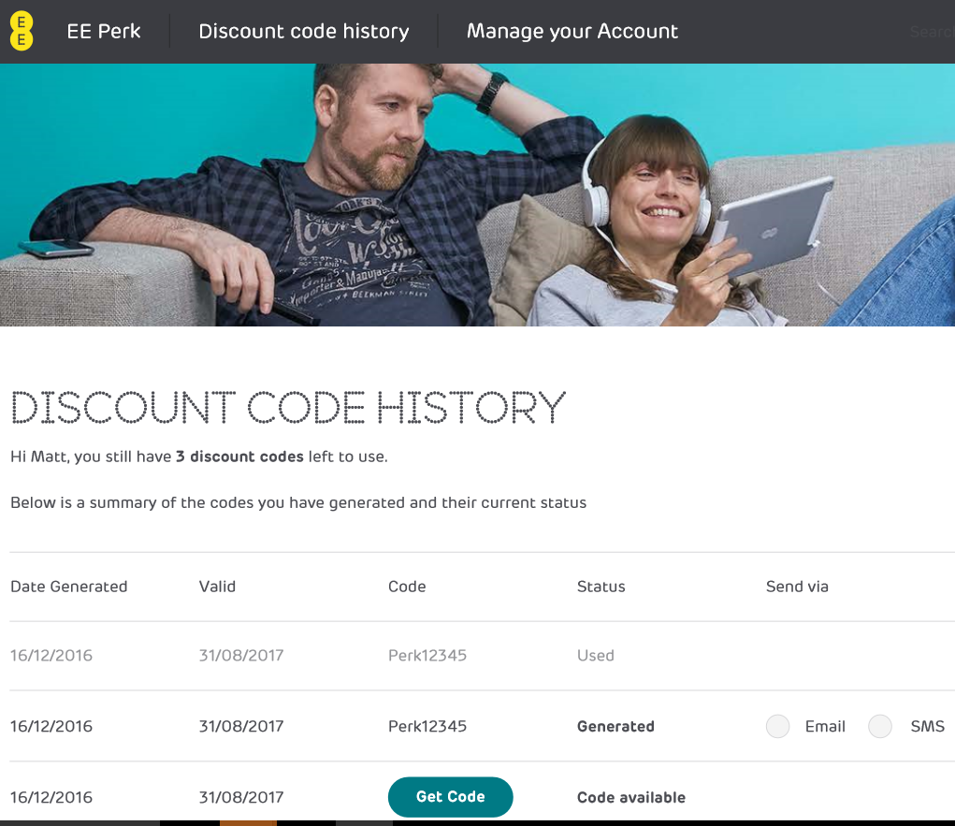
STEP 5 – DISCOUNT CODES
Once logged in the employee can:
Access up to 5 unique codes
Check if codes have been redeemed
Send on codes to friends and family
Perk Code ‘Perk12345’ used
Click ‘Get Code’ to access the code

Slide 9
EE PERK
How to order with the discount code

Slide 10
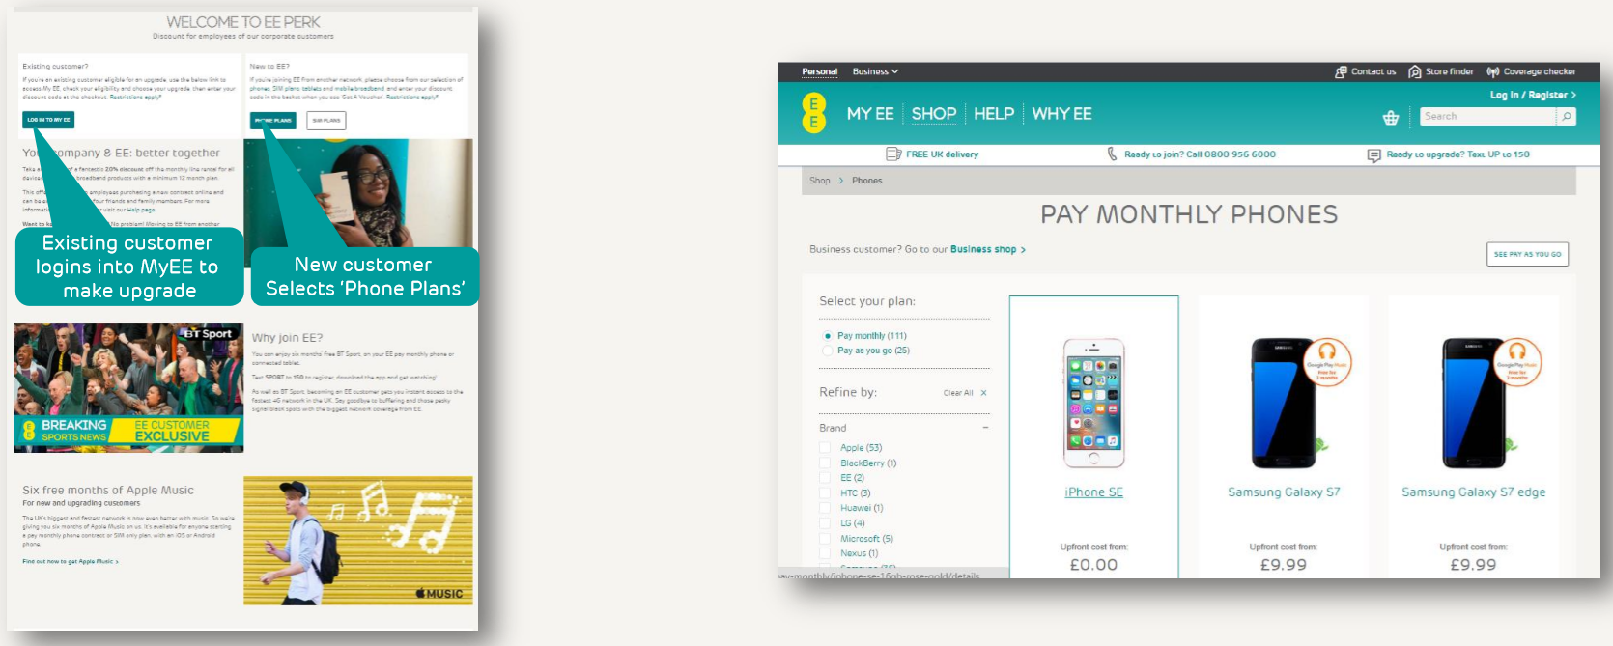
EE PERK – ORDER PROCESS
Once they have their codes, employees can return to ee.co.uk/perk, log in to MyEE as an existing EE customer or go straight to ee.co.uk/shop to search for a plan.
Once a plan has been selected click through to online basket

Slide 11
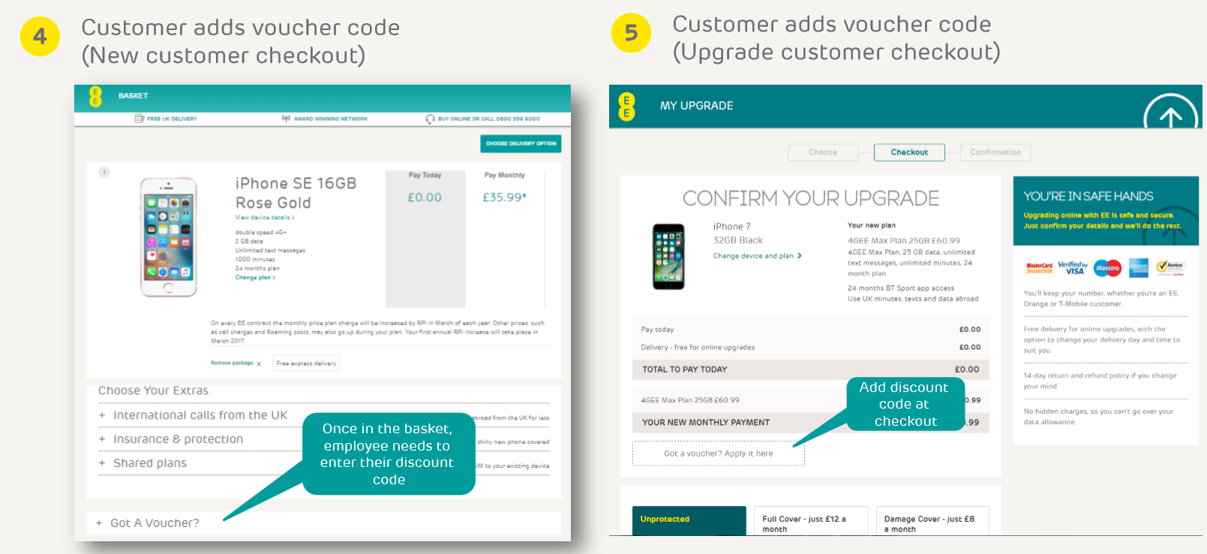
EE PERK – ORDER PROCESS
1.
2.

Slide 12
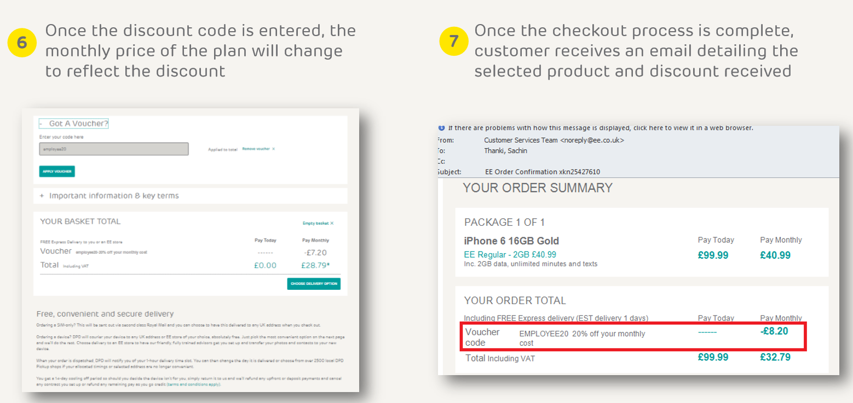
EE PERK – ORDER PROCESS
3.
4.

Slide 13
APPENDIX

Slide 14
FAQs
PERK – FAQ’s
Blue Light Cards/ Defence Discount Cards: Customer is trying to sign up for EE Perk using a Blue Light or Defence Discount card. Please refer the customer to the Blue Light / Defence Discount web site for their terms and conditions as we have changed the way our partners and their employees obtain their discount.
Alternatively the customer can register for EE Perk using a valid branded photo ID card. This can be done by going to the Perk Page This can be done by going to the Perk page using your own mobile device browser at https://perk.ee.co.uk/ clicking on the “Perk Portal “ link which will then take you to the registration page.
Blue Light Cards/ Defence Discount Cards – Veterans: Customer is a veteran and is trying to sign up for EE Perk. This can be done by going to the Perk page using their own mobile device browser at https://perk.ee.co.uk/ clicking on the “Perk Portal “link which will then take you to the registration page. The customer will need to upload one of the following forms of ID to register along with their personal email address. Forms of ID accepted are: Certificate of Service – Certificate of Discharge –Letter confirming Armed Forces Pension.
Email Domain Is Not Recognised: Employee to contact their HR Team as they will need to request the email domain be registered via an EE Account Manager. Perk Team are unable to register an email domain without being requested via Account Manager.
Deactivated Application: Customer has tried to sign up but their registration is showing as “deactivated”. Customer will contact EE to advise of the issue. Perk Team will remove the deactivated details from the Perk Portal to allow them to re-register. Customer must ensure they validate their email address in order for the registration to be completed.
Password Reset: Customer is trying to reset their password but has not received the email to do so. Customer to ensure they have validated their email address as if it has not been validated the password reset email will not recognise where it has to go.
If it has been successfully validated the customer will need to check their Spam/Junk folder. If it is a company email address they would need to check with their IT Team to ensure there are no filters on the email blocking external emails from being received. If all correct and filters checked Perk Team to send off to their support Team for it to be checked.
Oops There’s a Problem: Customer contacts EE to advise when trying to sign up they are getting an error “oops there’s a problem”. Please ask Customer to sign up using their own mobile device browser and not through a 3rd party app such as Blue Light or Defence Discount as will generate an error “oops there’s an error please check 3rd party cookies.
This can be done by going to the Perk page using their own mobile device browser at https//perk.ee.co.uk/. Click on the Perk portal link which will then take you to the registration page.

Slide 15
The legal bit
If you’re employed directly by an EE Corporate customer or EE approved partner , you could get a 20% discount on selected pay monthly price plans from EE.
The discount can only be used by eligible employees and up to four members of your friends and family or, if you do not use it for yourself, up to five members of your friends and family. The discount is available online at www.ee.co.uk/shop, via EE retail stores and by calling upgrade teams on 150 from an EE phone. Discount is not available through 3rd party retailers.
Eligibility: To be eligible, you must be an employee of an EE Corporate customer or an EE approved partner. You, or members of your family and friends, must either:
join EE as a new customer on a consumer pay monthly phone, eligible SIM only or mobile broadband plan with a minimum term of at least 12 months
be an upgrade eligible existing EE customer on a consumer pay monthly phone, eligible SIM only or mobile broadband plan with a minimum term of at least 12 months, and upgrade to a new consumer pay monthly handset, SIM only or mobile broadband plan with a minimum term of at least 12 months. If you currently have a phone plan you cannot upgrade to a SIM only plan and get this discount.
The discount will only be applied if you use the code that we supply
Eligible employees and your friends and family may obtain the discount on up to five EE price plans in total.
The discount: The 20% discount will only apply to the price plan’s monthly recurring charge and will last for the duration of your minimum term. At the end of your minimum term, your price plan’s monthly recurring charge will revert to the usual pre-discount price, unless you upgrade again using a new EE Perk code.
Your price plan monthly recurring charge will be increased by RPI in March each year. The calculation will be based on the non-discounted price of your plan
Non-eligible plans: The discount cannot be used in conjunction with any other offer or discount. It is not available with Family & Friends, 10% Multi-line, early upgrade discount or Apple Watch (any series), Gift with Purchase offers, Time Limited special offers.
In addition to these offer terms and conditions, you must also agree to the terms applicable to your chosen pay monthly price plan and EE’s network terms. These can be found on ee.co.uk/terms.

